Slide 1
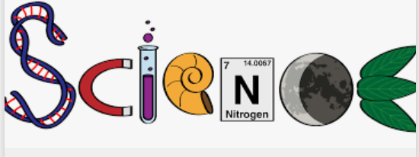

Year 5
Start Right Science

Slide 2
How many working scientifically skills can you remember from Year 4?
Asking questions and answering them using scientific investigations.
Making careful observations and taking accurate measurements.
Setting up practical enquiries and fair tests.
Grouping, classifying, recording and presenting data.
Looking at changes, patterns, similarities and differences in data.
Using results to make conclusions and new predictions.

Slide 3
In Year 5, we have more working scientifically skills added to make science even more exciting!
Planning your own scientific investigations to answer questions.
Understanding variables and fair testing in more detail.
Taking measurements and repeat readings for more accuracy – working out the average result.
Recording scientific data in different ways.
Using test results to make predictions for further comparative and fair tests.
Researching to identify relevant scientific evidence.

Slide 4
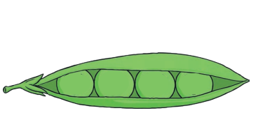
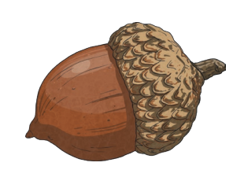
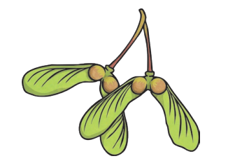
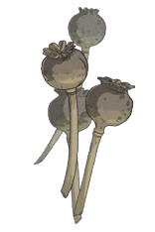
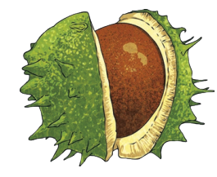
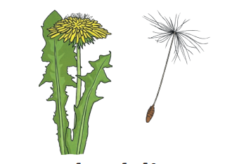
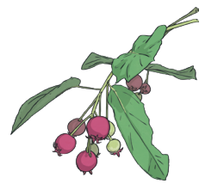
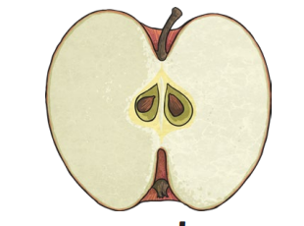
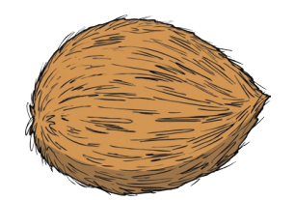
Investigation question:
Which of the collected seeds can travel furthest from its parent plant through the air?

Slide 5
Observation Retrieval
Great scientists use careful observations to make predictions, record results and come to conclusions that can change the world. Tell your partner:
About observations in science you made in Year 4 – how did they help your learning?
Are these skills only useful in science? Where else have you used them?
How can you make your observation skills the best they can be?

Slide 6
Starter: Observation & Sorting Task
Observe the selection of seeds on your table. Work with your group to complete the sorting task below:
Write a list of different ways the seeds could be sorted on a white board.
Work as a team to sort and group them in the different ways you thought of.
Discuss any knowledge you have about their names.
Think about how they might travel away from parent plants so that they can grow into new plants.
Be ready to share!

Slide 7
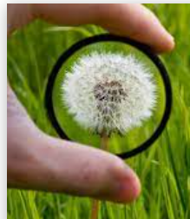
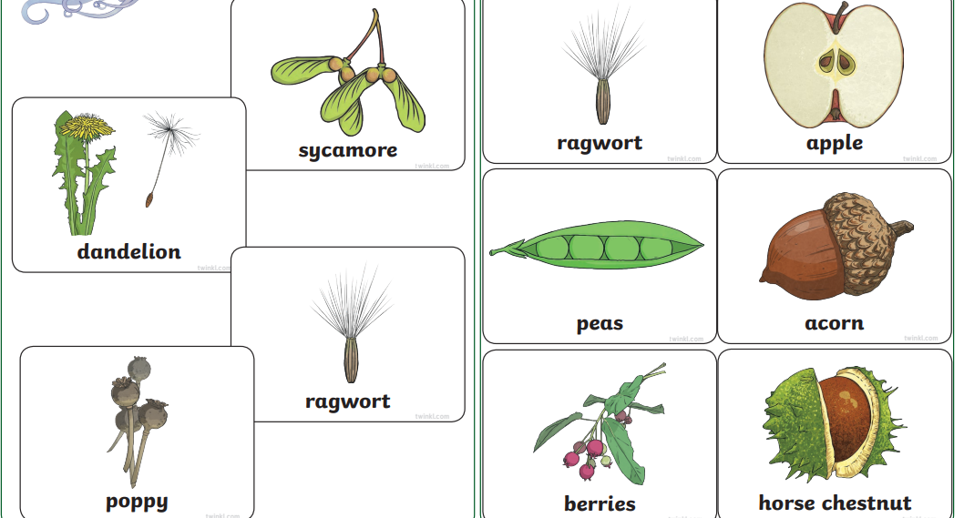
Different Types of Seeds

Slide 8
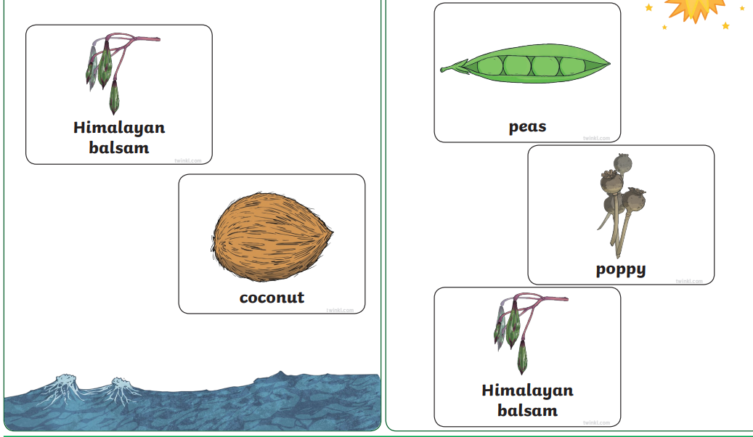

Slide 9
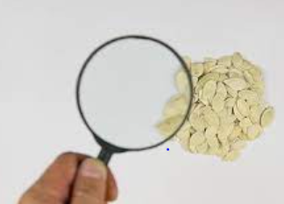
Retrieval: Seed Dispersal
Think back to your learning about seed dispersal in Year 3:
1. What is a seed?
2. What does seed dispersal mean?
What are the different types of seed dispersal?
Why is seed dispersal vital to plant species’ survival?

Slide 10
Retrieval: Seed Dispersal
Think back to your learning about seeds in Year 3:
1. Seeds are formed when pollen from the male part of the flower lands on the female part of the flower. Fertilisation takes place and the ovule (female part) develops into a seed.
2. Seed dispersal is the different ways used by plants to make their seeds travel as far as possible to keep their species going and be one of the strongest to survive as long as possible.
3. The different types of seed dispersal are: water; wind; dropping (gravity); eating; shaking; bursting; carrying.
Click for Seed Dispersal PPT

Slide 11
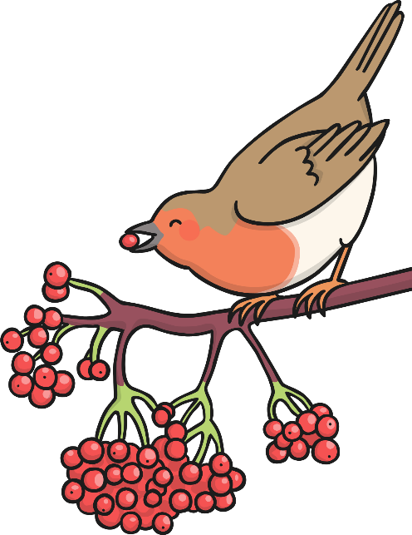
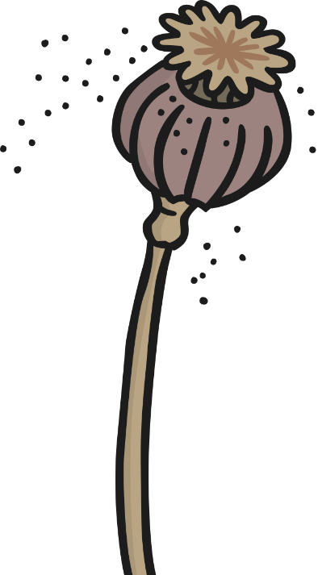
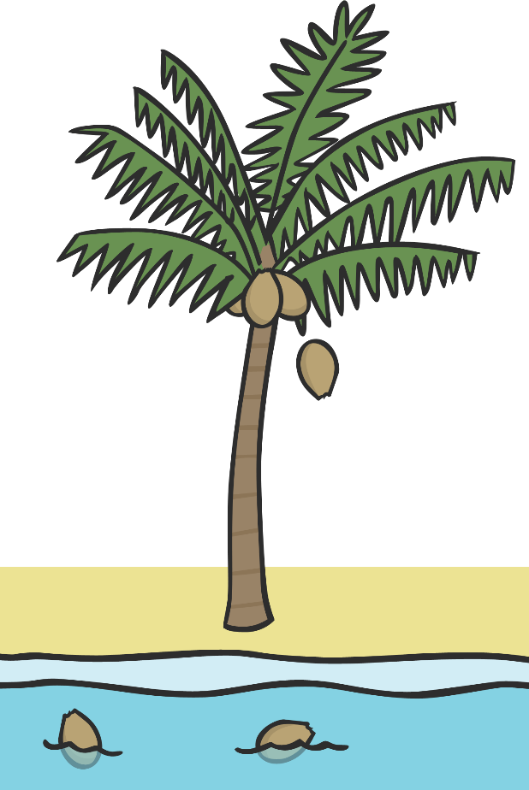
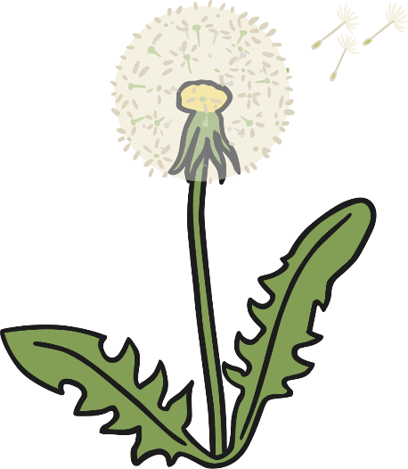

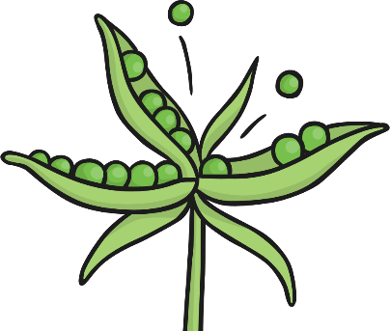
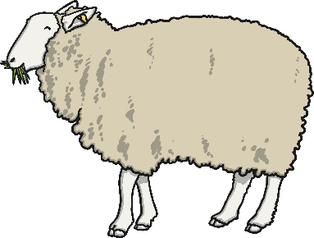

Possible ways of sorting and grouping:
shape; colour; size; style (vegetable, fruit, flowers, winged, hooked etc.); weight; hardness; method of seed dispersal.
Seeds can be dispersed by:
eating
the wind
shaking
water
dropping
bursting
carrying
Notes:
Taking a look at the seeds, identify which are dispersed in the wind and create a group. What do these seeds have in common and can they be divided into smaller groups? Parachute seeds (e.g. dandelion) and fruit (covered in fine hairs to make the seeds buoyant) and winged seeds (the wing slows the falling seeds, enabling them to float and spread quite far away from the parent plant).

Slide 12
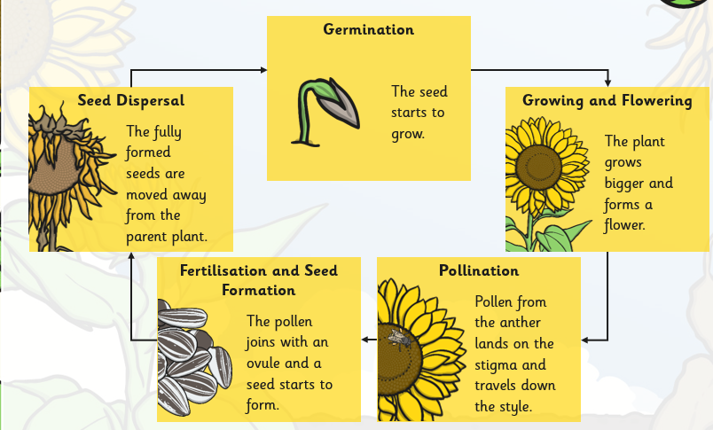
Retrieval: where does seed dispersal occur in the life cycle of a plant?
Do you remember the plant life cycle you drew in Year 3?

Slide 13
Retrieval:The Life Cycle of a Plant
Do you remember the plant life cycle you drew in Year 3?
This stage is our investigation focus.

Slide 14
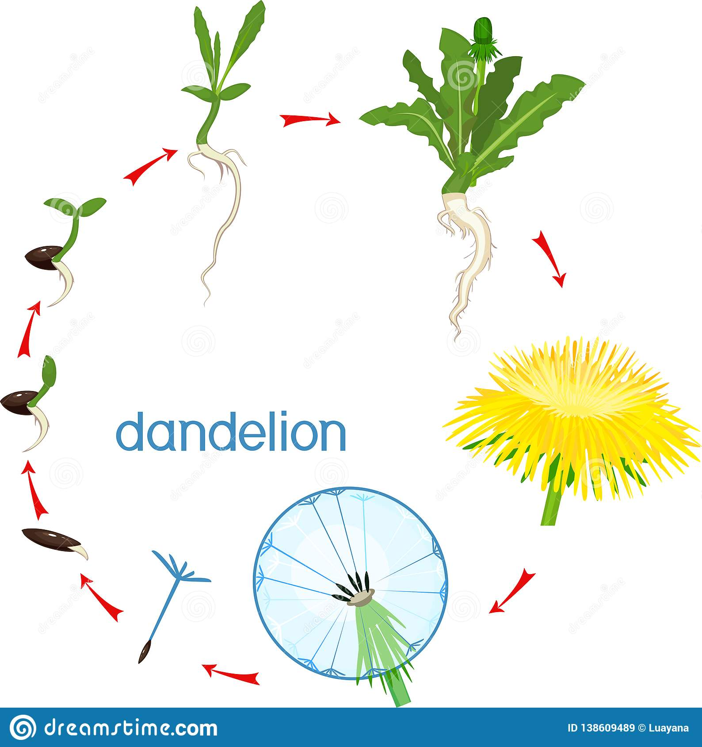
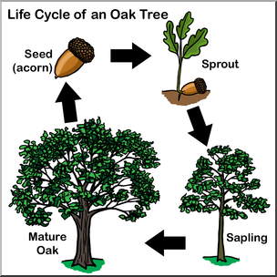

Slide 15

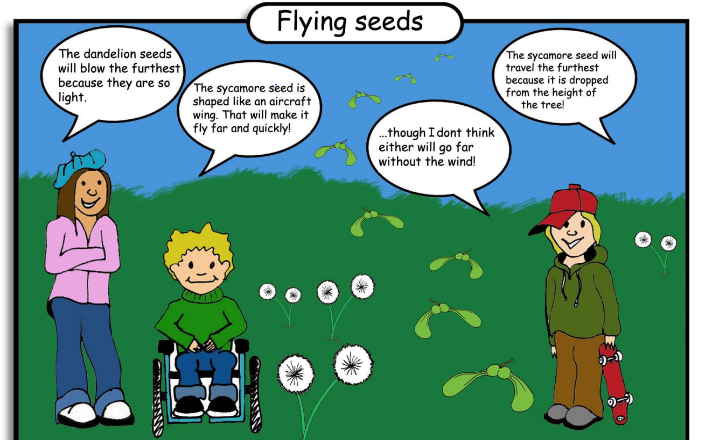
Investigation question:
Which of the collected seeds can travel furthest from its parent plant through the air?
Do you agree with the children?
Explain your reasoning.
Notes:
The winged seeds, e.g. ash and sycamore, spiral and twist because of their shape as well as being blown by the wind. Parachute seeds, e.g. dandelion, sometimes single seed floating in wind, sometimes several tangled in a cluster – larger surface area for wind to catch.

Slide 16
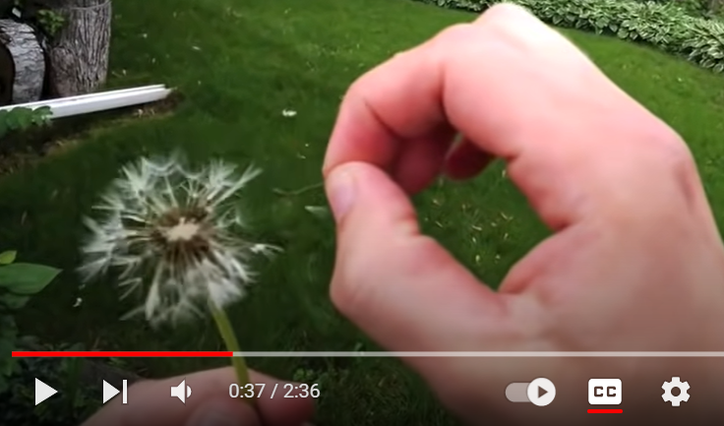
Investigation question:
Which of the collected seeds can travel furthest from its parent plant through the air?
Notes:
The winged seeds, e.g. ash and sycamore, spiral and twist because of their shape as well as being blown by the wind. Parachute seeds, e.g. dandelion, sometimes single seed floating in wind, sometimes several tangled in a cluster – larger surface area for wind to catch.

Slide 17
How could you investigate this?
Investigation question:
Which of the collected seeds can travel furthest from its parent plant through the air?
What could you measure?
What equipment might you need?
How could you make sure the results are accurate?
How will you know which seed travels the furthest?
How will you make sure that it is a fair test?

Slide 18
Variables
In all investigations:
The independent variable is………
What I change.
The dependent variable is………..
What I measure.
The control variables are………….
What I keep the same to ensure a fair test.
What will these be in our investigation?
Notes:
Independent variable: type of seed
Control variables: Seeds dropped from the same height; same strength of wind (use of cooling fan same distance away each time); metre ruler/tape measure lined up accurately at 0 each time etc.
Dependent variable: how many cm the seed travels in ‘the wind’.

Slide 19
LO: to work scientifically to answer a question.
Investigation Question:
Which of the collected seeds can travel furthest from its parent plant through the air?
Fair Test:
In order to keep it a fair test, we will keep the following control variables the same: ………………………………… .
The independent variable (the one thing that changes each time) will be ……………………………………………. .
We will measure ………………………………………. .

Slide 20
Planning:
Prediction: (what will happen and why do you think this?)
I think that the ________________ will be blown the longest
distance and so could travel the furthest from its parent plant.
This is because ____________________ .
The __________ would be closest to the parent plant
because _____________________________ .
Think about the properties and features of the seeds we discussed earlier.

Slide 21
Planning:
Equipment:
Collection of seeds
Cooling fan/hairdryer
Measuring sticks/tapes
Method:
Discuss the equipment and method in your groups and be ready to share your ideas. You don’t need to write these in your book.

Slide 22
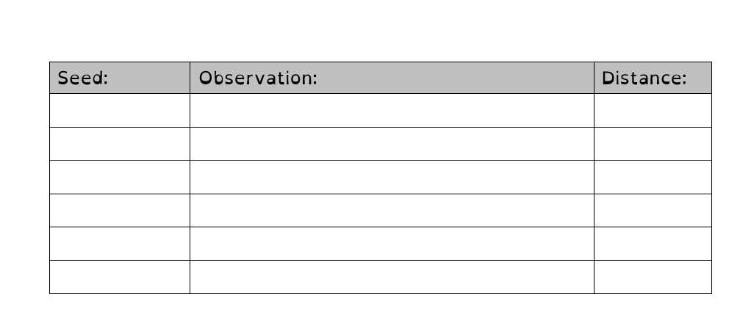
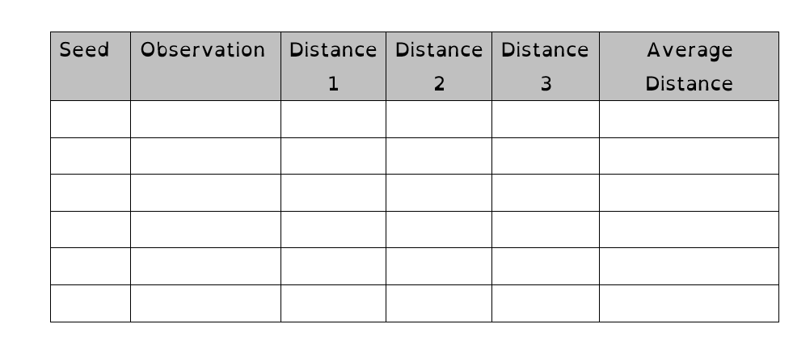
Results:
How could you present your results in a different way?

Slide 23
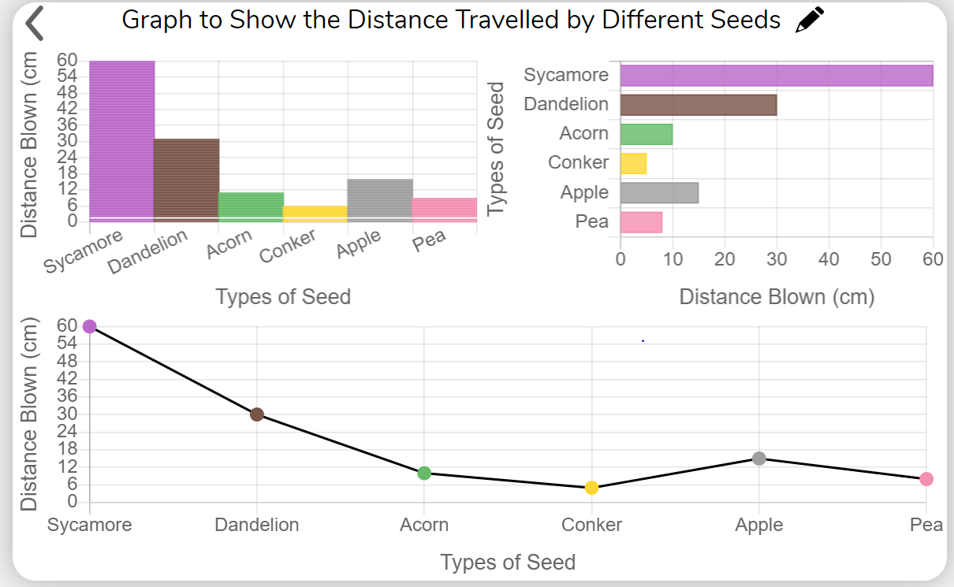
Results: Graph Examples
(the distance is made up for each seed, just as an example, so your results might look very different)
Use 2Graph on Purple Mash or draw your own to reflect your results.

Slide 24
Conclusion:
Which seed was blown the furthest? What was its result? Why do you think it went the furthest? Link to its properties
Which seed travelled the least distance? What was its result? Why do you think it didn’t travel far? Link to its properties
Was your prediction correct?
Can you see any patterns in the results?
How could you take this investigation further? What else could you test/change? Are there any improvements you would make it you did it again?

Slide 25

Plenary Challenge:
Create the best shape of post-it to travel the furthest through the air!
Using what you have observed during the investigation, make changes to the shape of your post-it, without getting rid of any of the paper (i.e. keep the same weight!). Using the same strength of wind, whose paper seed will travel the furthest?

Slide 26
How many of the Year 5 working scientifically skills have you used in this investigation?
Planning your own scientific investigations to answer questions.
Understanding variables and fair testing in more detail.
Taking measurements and repeat readings for more accuracy – working out the average result.
Recording scientific data in different ways.
Using test results to make predictions for further comparative and fair tests.
Researching to identify relevant scientific evidence.
How can we improve our working scientifically skills, next lesson?

